Slide 1


Simplifying the business of benefit administration
Office of the State Treasurer
Employee Benefit Open Enrollment

Slide 2
Taylor & Sons Background
56+ year history serving our Clients
TPA services provided since 1978
Voluntary Benefits Broker/Best of Class Products
Employee Education & Enrollment Services
Customized solutions
Long Term Relationships

Slide 3

What makes us stand out?
Independent
Purchasing Power
Commitment to Long Term Relationships
Live Customer Service (no phone maze)

Slide 4

We Represent You- Best in Class Products
Partial List of Carrier Relationships

Slide 5
What we do…Customer Service

Slide 6


Employee Communication
Holistic approach that improves employee engagement
Communication Included:
Customized Plans
Group Presentations
Enrollment Packets
One-on-One Meetings
Posters
Videos
Handouts
Web content
Call Center
Tailored to meet client needs

Slide 7

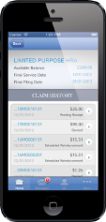
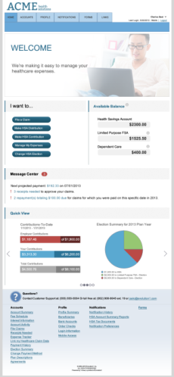




Flexible Spending
Mobile
Mobile app lets tech-savvy consumers manage their accounts right from their phone.
Automated Communications
Over 10 statements and notifications – all accessible via e-mail, consumer portal, and mobile app
CONSUMER TOOLS
Flexible Payment Options
Consumer can choose from:
Debit card, which increases
consumer satisfaction
by reducing paperwork.
Consumer-Initiated Payment
on Consumer Portal
Claims Exchange with auto-pay
or Expense Tracker
Consumer
Portal
Robust portal empowers consumers, providing everything they need to know about their account, with an industry-leading design that enables quick and easy navigation of content.

Slide 8
Benefits offered to employees
Dental
Vision
Disability
Cancer
Voluntary Life

Slide 9

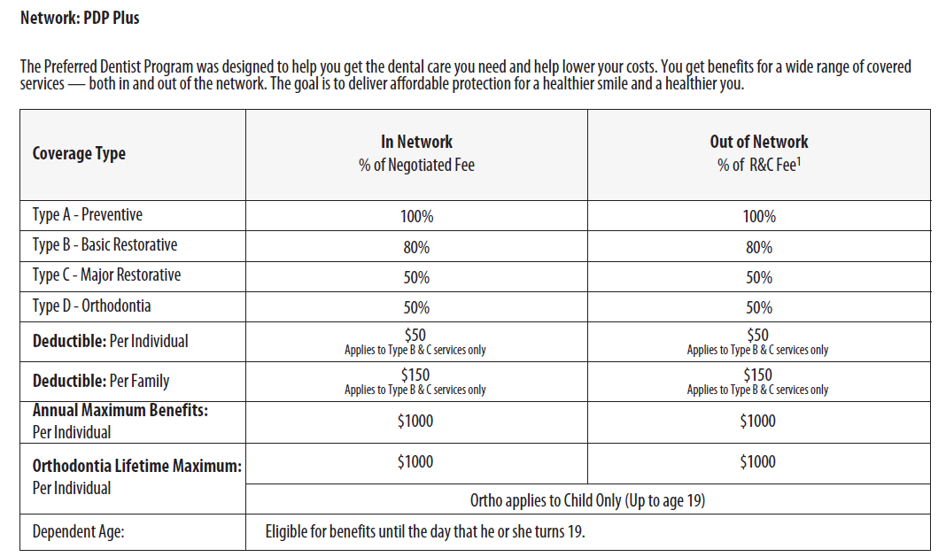
MetLife Dental
No changes to benefits
Same carrier as we have had
This slide is for illustrative purposes only. In the event of a discrepancy the actual policy will prevail.

Slide 10

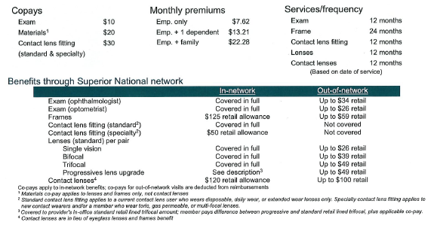
Vision
This slide is for illustrative purposes only. In the event of a discrepancy the actual policy will prevail.

Slide 11
Value-added Vision Benefits
Significant discounts on an unlimited number of additional eyeglasses and contact lenses
Stand-alone Contact Lens Fitting benefit; leaves entire contact lens allowance available for materials
Vast Provider Network
Broadest provider network of MDs, ODs, and optical chains
In-network chains include:
5% - 50% discounts on LASIK
More than 55,000 providers nationwide
Sam’s Club Optical Sears Optical
Target Optical Pearle Vision
Costco Optical Visionworks
Members may use different providers for their eye exam and their materials
LensCrafters Walmart Vision Center

Slide 12

Voluntary Term Life Insurance
GI EE | $100,000
Max issue | 5 x salary to $500k
GI Sp | $35,000
Employee cost per $1,000
Age | Cigna
20-24 | $0.130
25-29 | $0.130
30-34 | $0.130
35-39 | $0.160
40-44 | $0.240
45-49 | $0.360
50-54 | $0.570
55-59 | $0.910
60-64 | $1.390
65-69 | $2.360
70-74 | $4.480
75-79 | $9.050
Child $10k | $2.60
Employee Guarantee Issue: $100,000
Maximum Amount Issued: 5 times salary up to $500,000
Spouse and child coverage available
Examples of Cost
$25,000 Death Benefit
Age 20 - 34 | $3.25
Age 35 - 39 | $4.00
Age 45 - 49 | $9.00
Age 55 - 59 | $22.75
$50,000 Death Benefit
Age 20 - 34 |  | $6.50
Age 35 - 39 |  | $8.00
Age 45 - 49 |  | $18.00
Age 55 - 59 |  | $45.50
This slide is for illustrative purposes only. In the event of a discrepancy the actual policy will prevail.

Slide 13

Disability Benefits -- Long (LTD) and Short Term(STD)
Through our history in working with Mississippi state agencies we have found that many times employees feel that they are provided disability coverage through PERS. We have provided a brief analysis of the PERS benefit on the following pages, as well as demographics related to your employee population. We go to great lengths to educate our clients’ employees related to the need (or not) for short and or long term disability. More often than not we recommend that an agency elect a disability plan that off sets with accumulated paid time off in order to hold the costs of disability premiums down.
The plan we offer does require that accumulated paid time off is used before the disability benefit begins. However, the plan we propose only reduces to 50% if PERS is the only off set...in other words should one qualify for PERS disability component then the proposed disability would pay in addition to the PERS benefit.
The carrier (Cigna) has the largest block of Mississippi state agency coverage to date. We have brokered this coverage in Mississippi for many years. We are offering short and long term disability. The disability offerings are guaranteed issued at initial open enrollment.
This slide is for illustrative purposes only. In the event of a discrepancy the actual policy will prevail.

Slide 14
Disability Retirement
Provided disability benefits are a component of your state retirement pension plan.
Benefits vary if incurred off the job or on the job.
Benefits can vary by length of service.
Approval for benefits is not automatic.
The application process normally takes 2-3 months.
Disability defined:
  Benefits are designed to provide a secure income to you if you become sick or injured, can no longer perform the essential duties of your job, and have a condition that is permanent in nature.
This slide is for illustrative purposes only. In the event of a discrepancy the actual policy will prevail.

Slide 15

Combining STD & LTD
Employees can choose to participate in one or both plans.
Employees who have immediate income replacement needs are encouraged to consider short-term disability.
Greater emphasis placed on the need for long-term disability.
This slide is for illustrative purposes only. In the event of a discrepancy the actual policy will prevail.

Slide 16
Who is not protecting their income against disability?
This slide is for illustrative purposes only. In the event of a discrepancy the actual policy will prevail.

Slide 17

Why do I need disability coverage?
Non-vested employees have a critical need for coverage.
Non-vested employees have no safety net other than SSDI whose approval rate is 37%, and average approval time is 17 months.
Currently, only permanent disability is covered.
Even vested members have significant exposure to loss.
Keep in mind most claims are generated away from the workplace (95%).
Work comp pays a max of $1,680. For employees earning more than $30,000 (77% of employees earn more that $30k). LTD could help supplement lost earnings and pick up where it ends.
This slide is for illustrative purposes only. In the event of a discrepancy the actual policy will prevail.

Slide 18
CIGNA – Short Term Disability Plan (STD)
Specifications | Cigna
Benefit % | 60% of weekly earnings
Max. Benefit | $1,000/week
GI limit | $1,000/week
Elimination Period | 14/14, 30/30, 60/60
Benefit Duration | 24 weeks, 22 weeks, 17 weeks
Pre-Existing Conditions | 3/12 Exclusion
This slide is for illustrative purposes only. In the event of a discrepancy the actual policy will prevail.

Slide 19
CIGNA – Long Term Disability (LTD)
Specifications | Cigna
Salary Definition | Monthly Earnings
Definition of Disability | unable to perform material and substantial duties, & 20% earnings loss
(during own occ period)
What are the offsets? | Includes, but not limited to: other group disability ins, retirement benefits, Social Security Act incl disability, workers comp.
Minimum Benefit | $100
Work Incentive Benefit | 100% pre-disability earnings for 1st 24 months
Own Occ. Period | 2 years
Benefit Duration | SSNRA
Max. Benefit | $5,000
Pre-Existing Conditions | 3/12 Exclusion
Benefit % | 60% of monthly earnings
Elim. Period | 180 Days
Integration Method | Primary and direct
Offset with PERS? | No
24 Month Limitations | Mental Nervous & Subst. Abuse
This slide is for illustrative purposes only. In the event of a discrepancy the actual policy will prevail.

Slide 20

Cancer Insurance
Cancer will strike….
1 in every 2 American Men
1 in every 3 American Women
These statistics are taken from the American Cancer Society’s
CANCER FACTS & FIGURES, 2009.
This slide is for illustrative purposes only. In the event of a discrepancy the actual policy will prevail.

Slide 21
Cancer Insurance
Cancer Facts
Cancer strikes at any age. More children ages 3 to 14 die from cancer than from any other disease. Cancer strikes more frequently with advancing age.
More than 73 million Americans now living will eventually have cancer; one in three persons according to present rates. Over the years cancer will strike approximately three of four American families.
There are over 5 million Americans alive today who have a history of cancer. There will be about 930,000 new cancer cases diagnosed this year.
Cancer is the second leading cause of death in the United States. Of every five deaths, one is from cancer.
Treatment is often OUT-OF-STATE and OUT-OF-HOSPITAL.
1 in 3 may be cured by early examination.
Cancer can cause financial hardships for a family.
This slide is for illustrative purposes only. In the event of a discrepancy the actual policy will prevail.

Slide 22
Cancer Insurance
Important Features
NO Physical exam required.
Guaranteed renewable for life.
Your policy cannot be canceled by the company except for non-payment of premiums.
Pays in addition to all other insurance.
Your premiums cannot be raised unless rates change for entire class.
Your policy is portable. It can go with you if you leave or retire.
This slide is for illustrative purposes only. In the event of a discrepancy the actual policy will prevail.

Slide 23
Cancer Insurance
Select Cancer Expense Program
Base Policy
(Cancer/Dread Disease)
SPECIAL MONTHLY PAYROLL RATES
 | Plan A | Plan B
Individual | $14.64 | $24.09
Single Parent | $18.40 | $29.27
Family | $25.05 | $40.41
This slide is for illustrative purposes only. In the event of a discrepancy the actual policy will prevail.

Slide 24
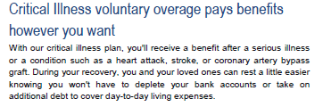
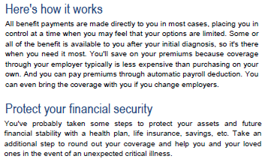
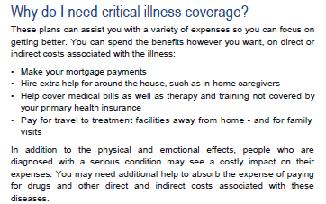
Critical Illness Insurance
This slide is for illustrative purposes only. In the event of a discrepancy the actual policy will prevail.

Slide 25
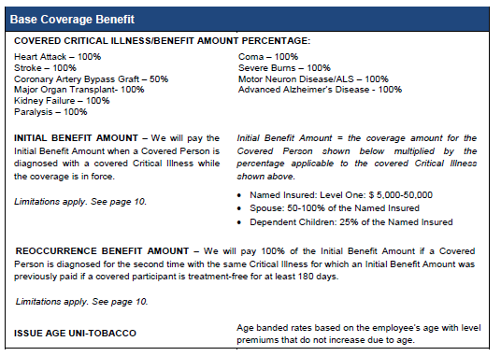
Additional Riders:
Annual Health Screening Benefit Rider: $50 per calendar year
ICU Benefit Rider: $100 per day
Specified Disease Rider – Initial Hospitalization $1500 per calendar year
And many other Expense Benefit Riders included (see brochure)
This slide is for illustrative purposes only. In the event of a discrepancy the actual policy will prevail.

Slide 26
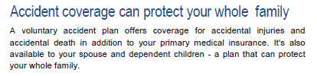
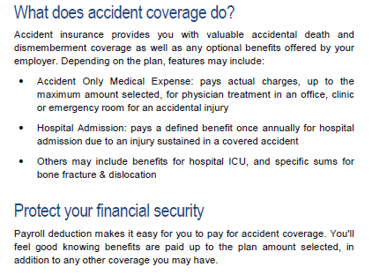
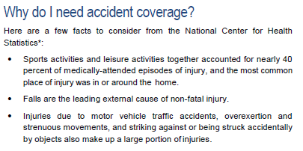
Accident Insurance
This slide is for illustrative purposes only. In the event of a discrepancy the actual policy will prevail.

Slide 27
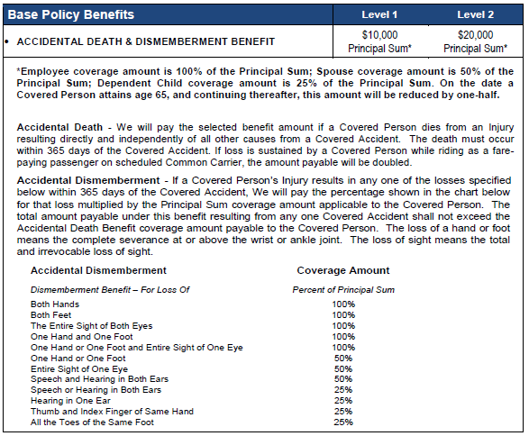
Additional Riders:
Annual Health Screening Benefit Rider: $50 per calendar year
Accident First Occurrence Benefits Rider: $50
Sports Package Benefit Rider: Included
Specific Sum Injury Benefit Rider: $5,000 or $10,000 option
Hospital Admission Benefit (Accident Only) Rider: $500 per calendar year
ICU Benefits Rider: $100 or $200 per day options
And many other Expense Benefit Riders included (see brochure)
This slide is for illustrative purposes only. In the event of a discrepancy the actual policy will prevail.

Slide 28


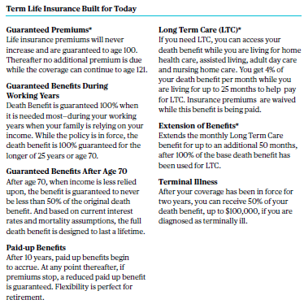
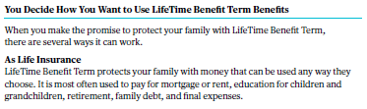
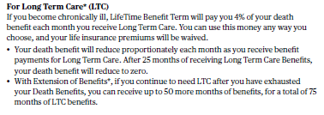

LifeTime Benefit Term Life with Long Term Care
This slide is for illustrative purposes only. In the event of a discrepancy the actual policy will prevail.

Slide 29
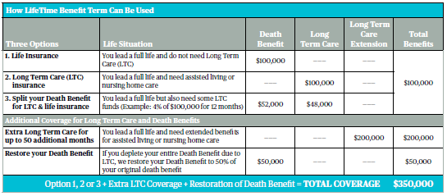
This slide is for illustrative purposes only. In the event of a discrepancy the actual policy will prevail.

Slide 30

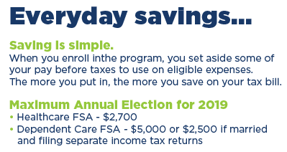
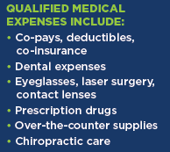
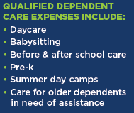
Flexible Spending Accounts –
Health Care Expense Reimbursement
Dependent Care Expense Reimbursement
This slide is for illustrative purposes only. In the event of a discrepancy the actual policy will prevail.

Slide 31


Additional Notes……
Open Enrollment: October 21 – 25, 2019
Self-Enrollment Available – 24 hours a day / 7 days a week during Open Enrollment Period.
Enroller on site Thursday, October 24 & Friday, October 25
Benefits Portal with general information on benefits – available 24 /7 www.mybenefitsportal.com/ost

